Slide 1
CS1501: Intro to Blockchain
From Cryptographic Primitives to Layer 2 Scaling

Slide 2
Intro to Blockchain Curriculum
Week 1: Incentive Loops and High-Level Blockchain Properties
Week 2: Hash Functions, Merkle Trees, and the Byzantine Generals Problem
Week 3: Guest Lecture by Josh Cincinnati on Bitcoin’s Proof of Work
Week 4: Redefining Permissionless for Proof of Stake Blockchains
Week 5: Guest Lecture by Glen Weyl on RadicalxMarkets
Week 6: Reviewing Cryptographic Primitives to Understand L2 Scaling
Week 7: Fork Choice Rules for Proof of Work vs Proof of Stake
Week 8: Fundamental Tradeoffs (Decentralizations, Scalability, Privacy/Security)
Week 9: L1 vs L2 Scaling
Weeks 10-12: TBD

Slide 3
10/5/2018 Roadmap
Asymmetric Cryptography
Signing and Verifying Transactions
Off-Chain Message Passing
Layer 2 Scaling Solutions (Lightning, State Channels, Plasma)

Slide 4
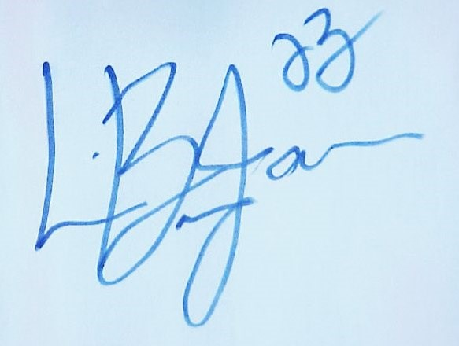

Signature

Slide 5
Purpose of Signatures?
Verification that the relevant person agreed to contract terms
Non-forgeable
Non-repudiation (no take backs!)

Slide 6
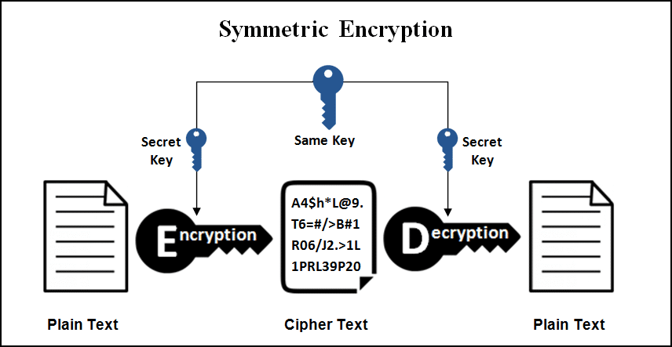
Symmetric Encryption
Bob wants to send a message M to Alice
Bob encrypts message M with key K to obtain ciphertext C
Bob sends ciphertext C to Alice
Alice uses the same key K to retrieve message M

Slide 7
Example: Bitwise XOR
Let’s assume we can convert a message M and key K to binary (0s and 1s). How can we use XOR in this context to encrypt M?
0 XOR 0 = ?
1 XOR 1 = ?
1 XOR 0 = ?
0 XOR 1 = ?

Slide 8
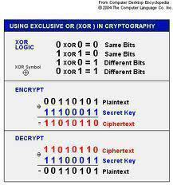
Example: XOR Encryption

Slide 9
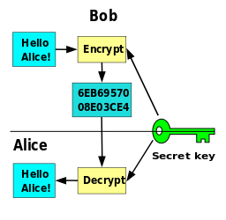
Pros and Cons of Symmetric Encryption
Pros:
Only 1 Key
Cons:
Shared Key
Not Scalable
Not Always Secure

Slide 10
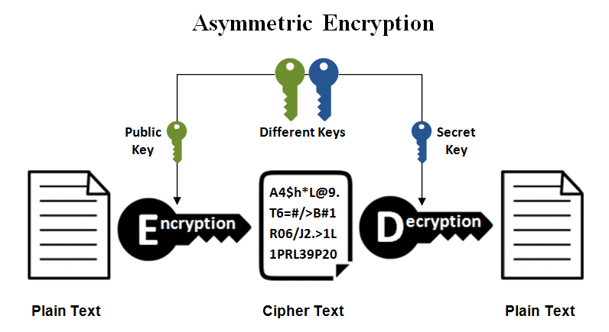
Asymmetric Cryptography
Uses a public key and a private key (2 keys) to encrypt and decrypt, respectively.
Building blocks: (1) Trapdoor Functions (2) Key Exchange

Slide 11
Relevant Use Cases
Public Key Cryptography (Encryption)
Message is encrypted with the recipient’s public key. The message cannot be decrypted by anyone who does not possess the matching private key
Digital Signatures
Message is signed with the sender’s private key and can be verified by anyone who has access to the sender’s public key.

Slide 12
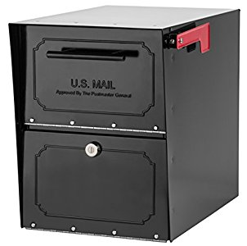
Public Key Cryptography (Encryption)
Locked mailbox with a mail slot. The mail slot is exposed and accessible to the public -- its location (the street address) is the public key.
Any ideas on how we could read the messages without the private key?

Slide 13
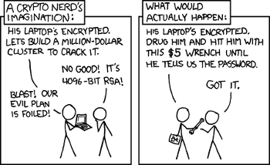
Wrench Attack

Slide 14
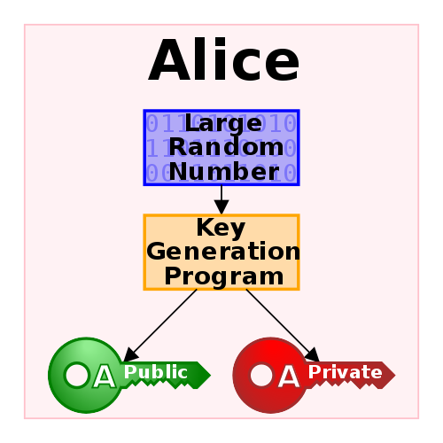
Key Generation
The private key is a random 256 bit data.
How secure is 256 bit security?
The public key corresponds to the private key, but does not need to be kept secret. The public key can be calculated from a private key but not vice versa.

Slide 15
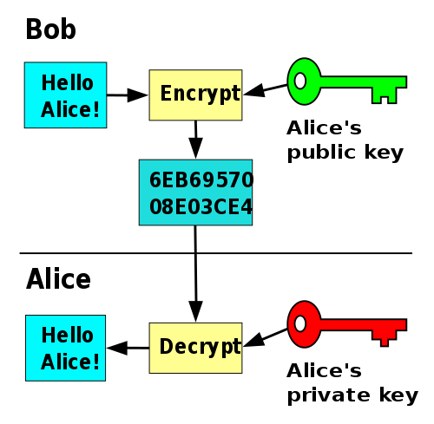
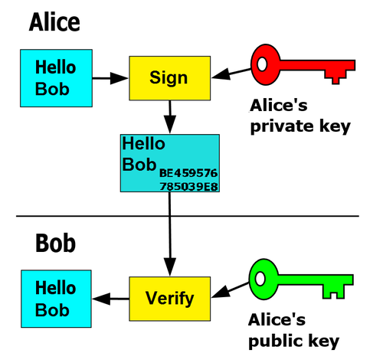
Asymmetric Encryption and Digital Signatures

Slide 16
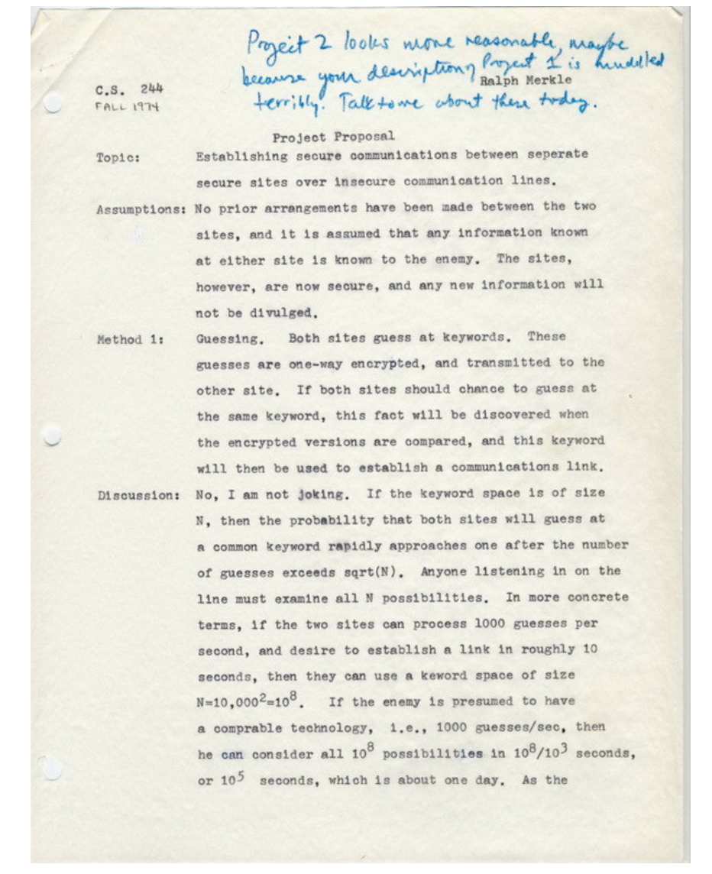
Some cool history -- Ralph Merkle

Slide 17
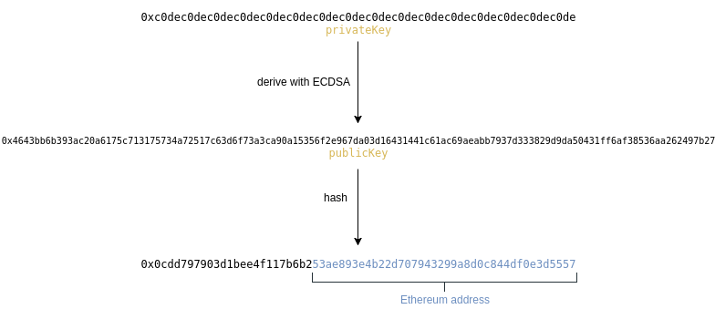
Ethereum

Slide 18
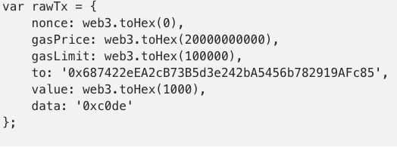
Ethereum Transaction
Nonce: number of outgoing transactions (starts at 0, iterates by 1)
gasPrice: price to determine amount of ether the transaction will cost
gasLimit: maximum gas spent to process the transaction
to: the account the transaction is sent to, if empty, the transaction will create a contract
Value: amount of ether to send
Data: any arbitrary message or function call to a contract or code to create a contract

Slide 19
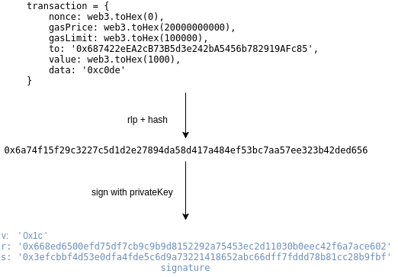
Signing a transaction

Slide 20
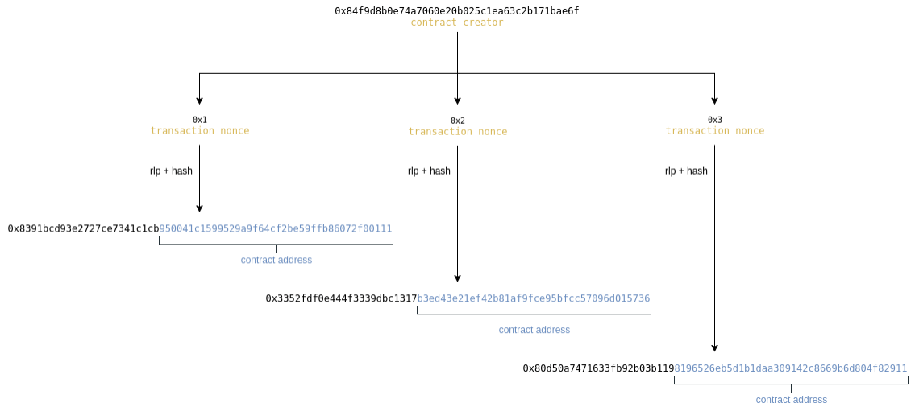
Signed Transaction

Slide 21

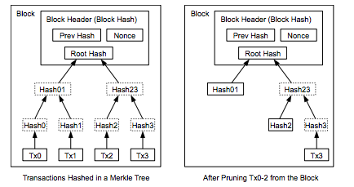
Putting it all together

Slide 22
Layer 1 vs Layer 2 Scaling

Slide 23
State Channels
Multisig
Two users lock the initial state (each party’s balance) into a multisig
Two parties transact by passing state updates amongst themselves
When parties have finished transacting, they each submit state updates to the smart contract
→ Challenge Period
-->Data Availability Problem
→ Tree in Forest Analogy
→ Speaker/Listener Fault Equivalence

Slide 24
Application: Micropayment Subscription Models
No transaction fees!

Slide 25
Counterfactual Instantiation
If time permits, do it;
Could also discuss signature aggregation

